Slide 1

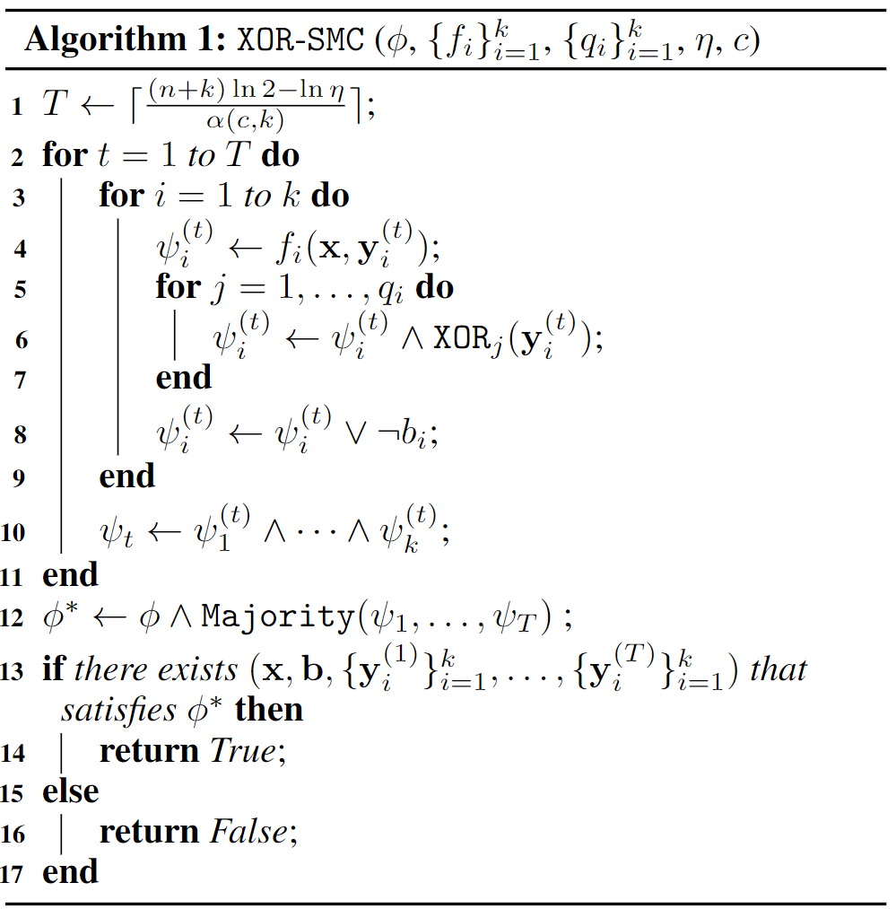
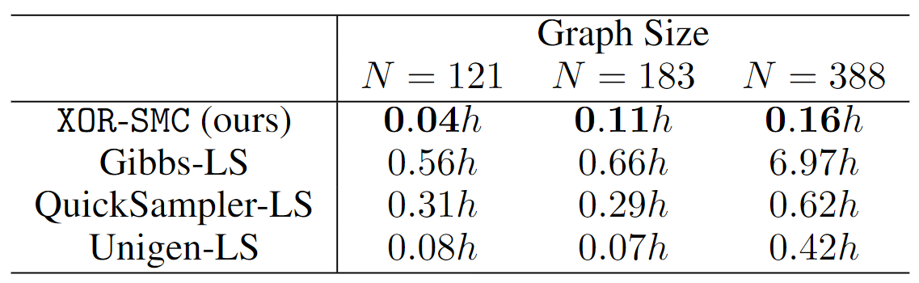

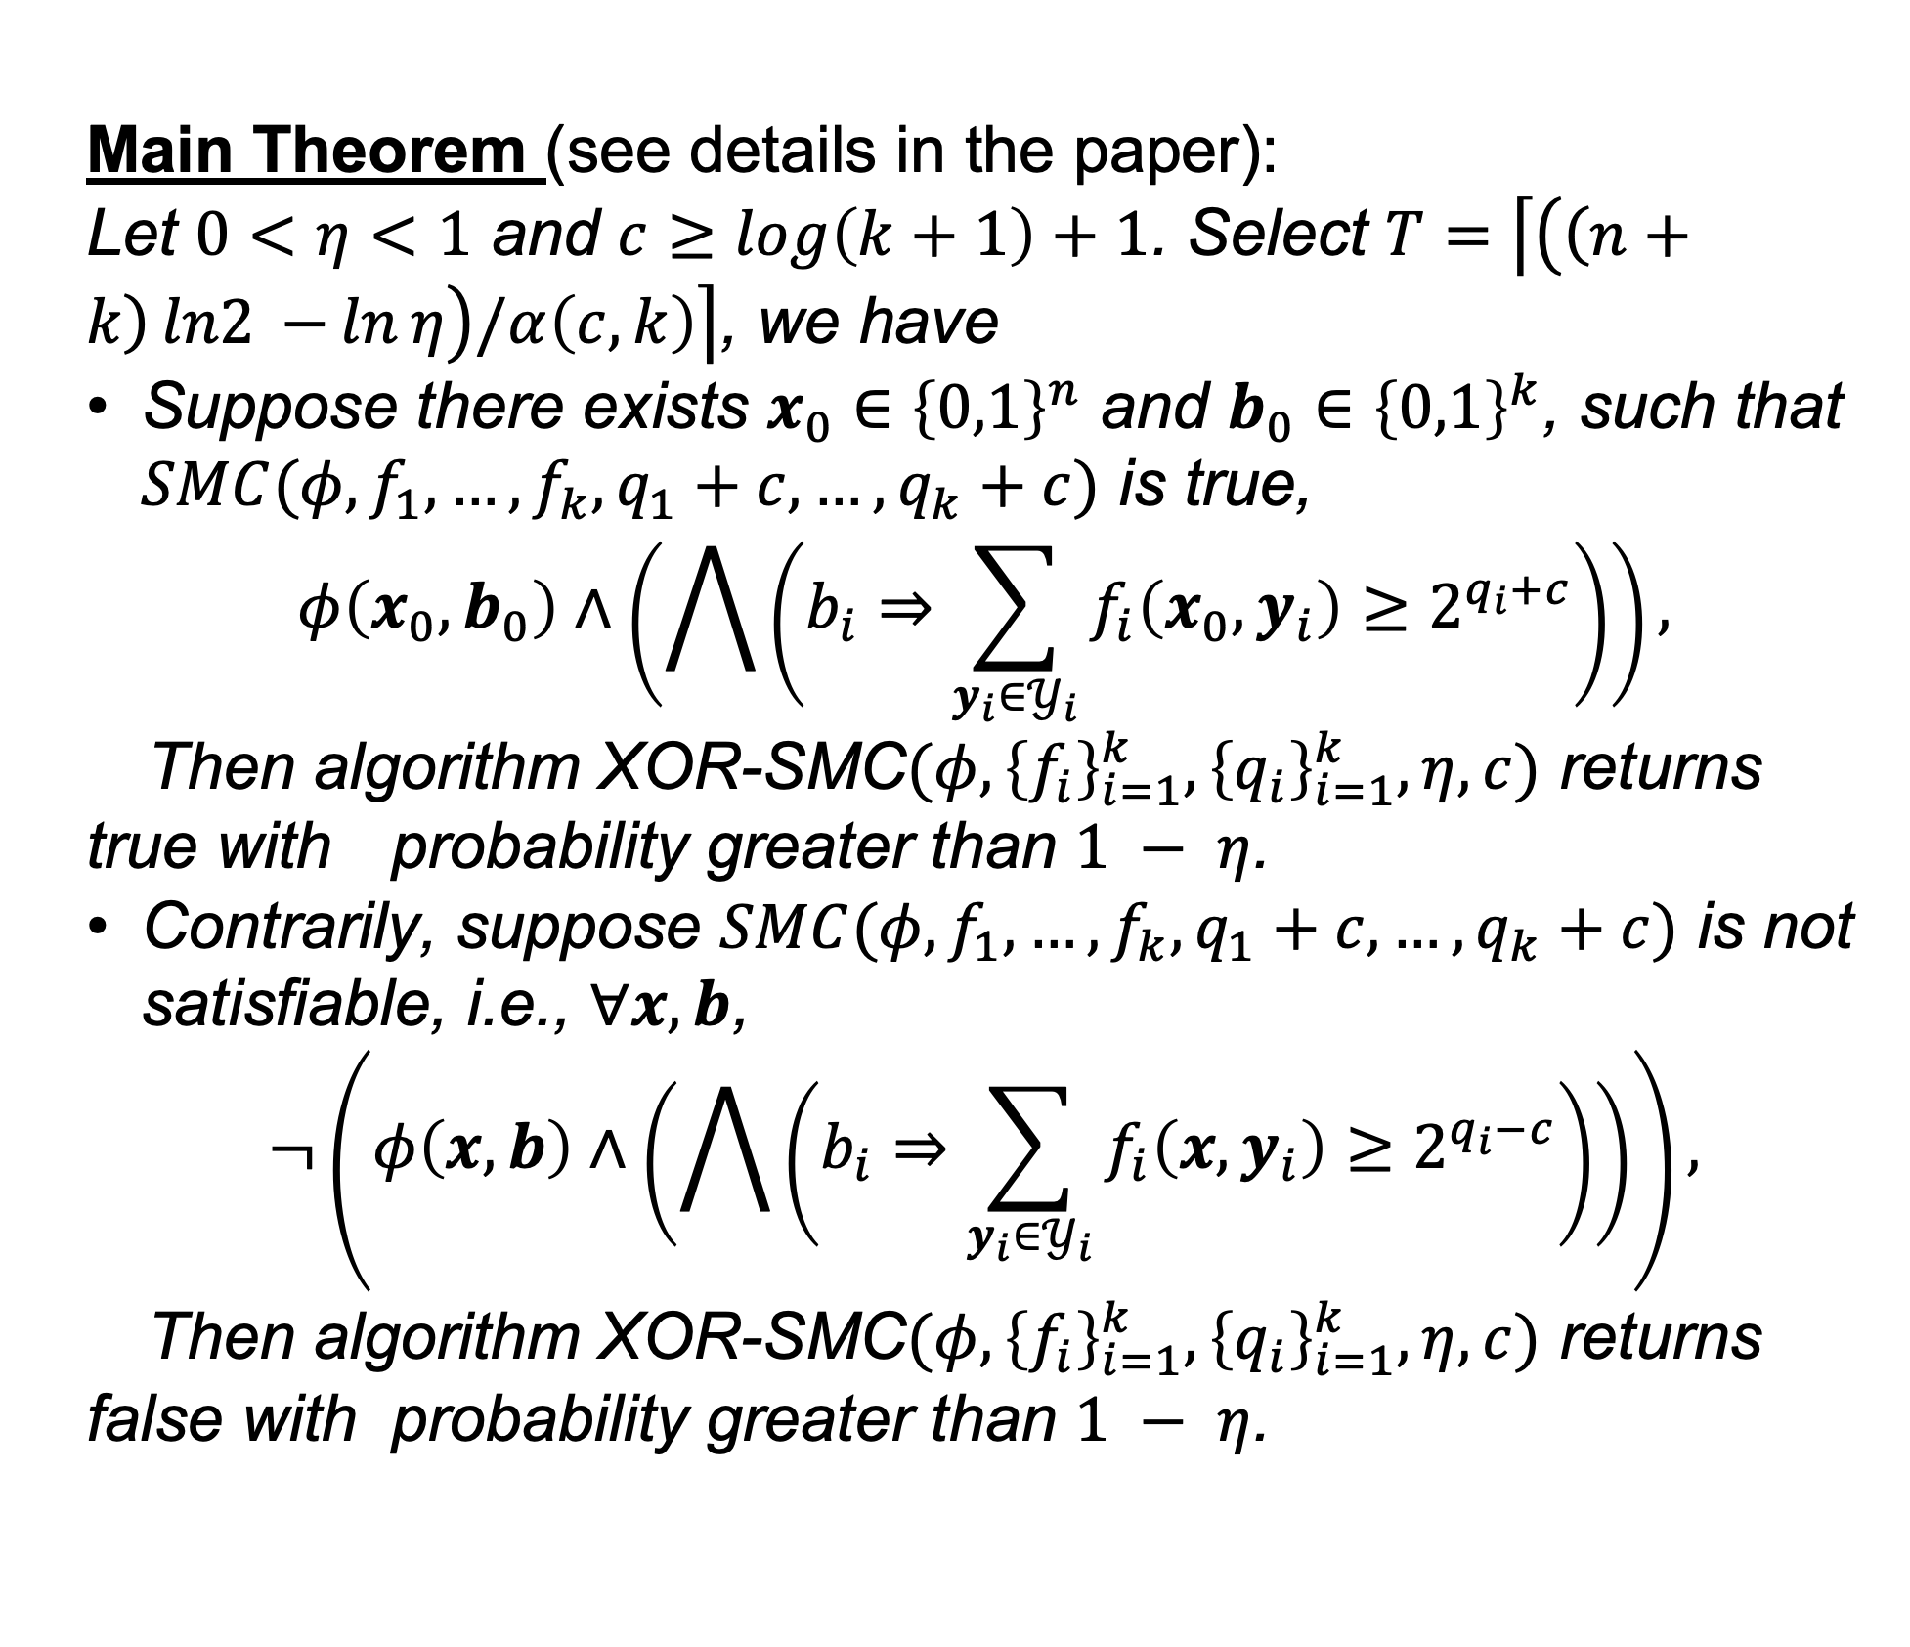
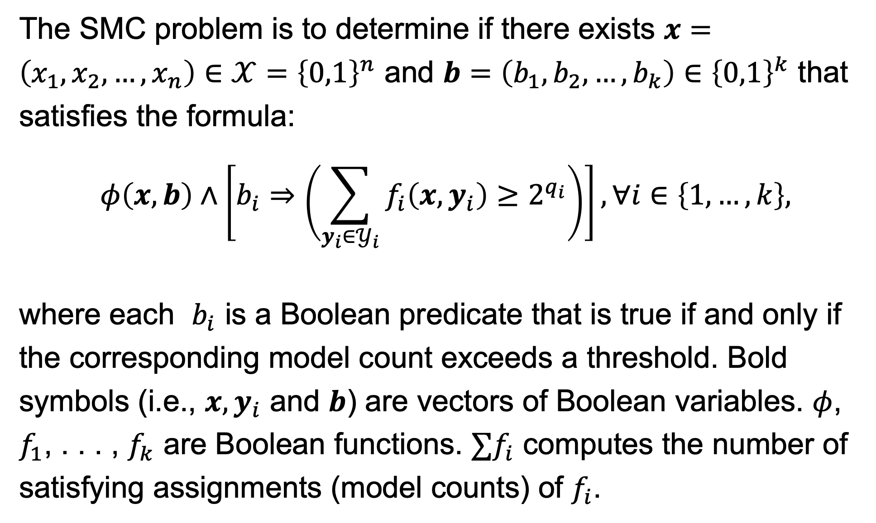
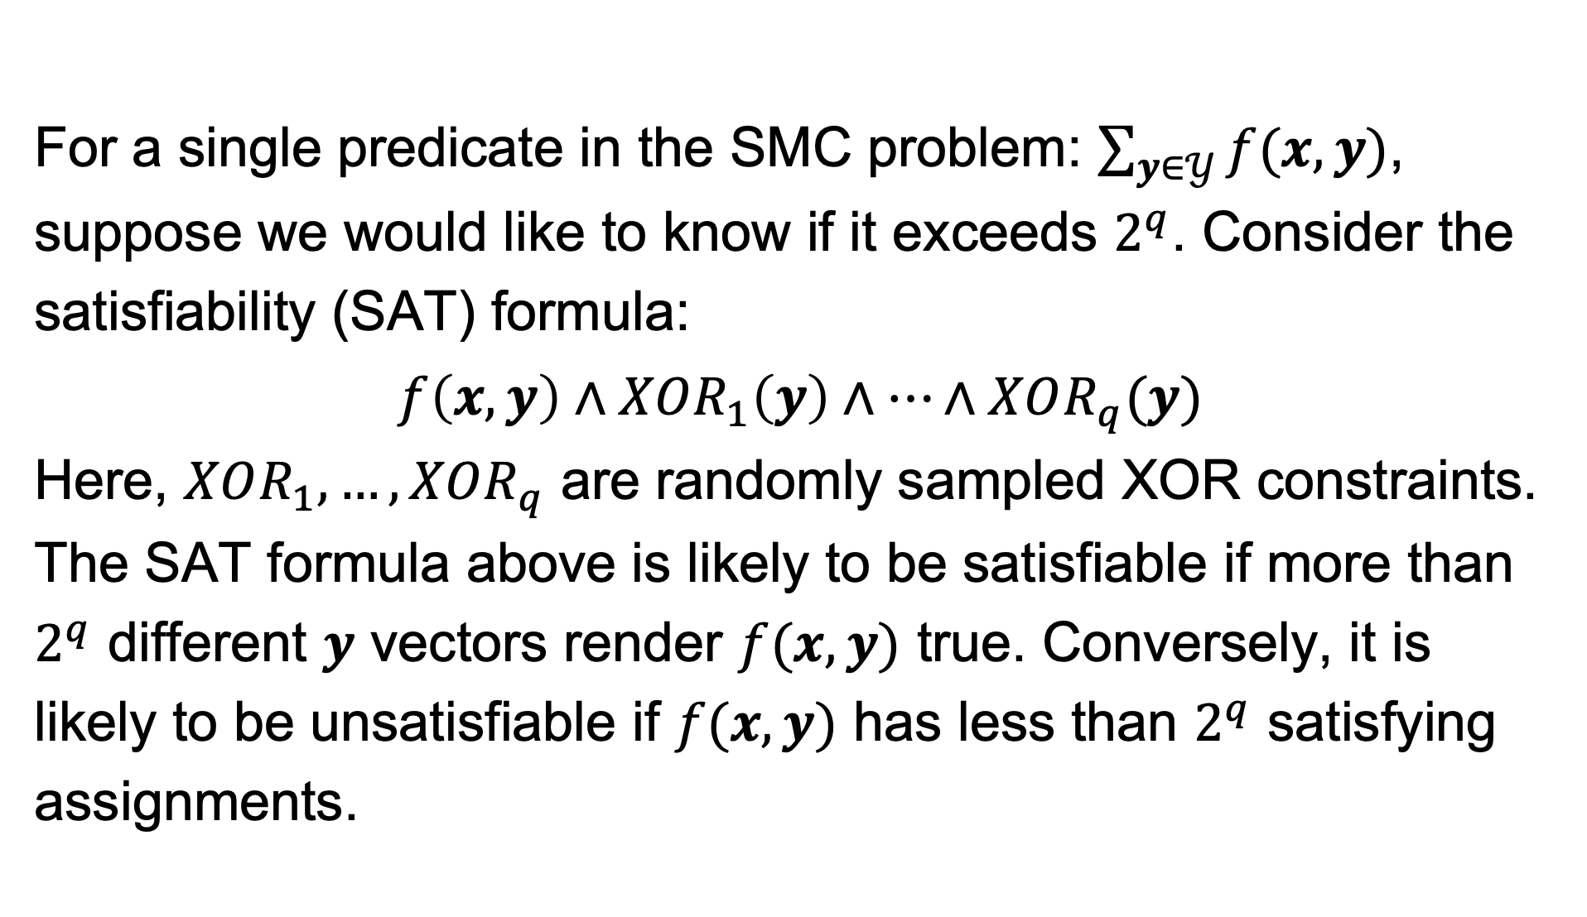
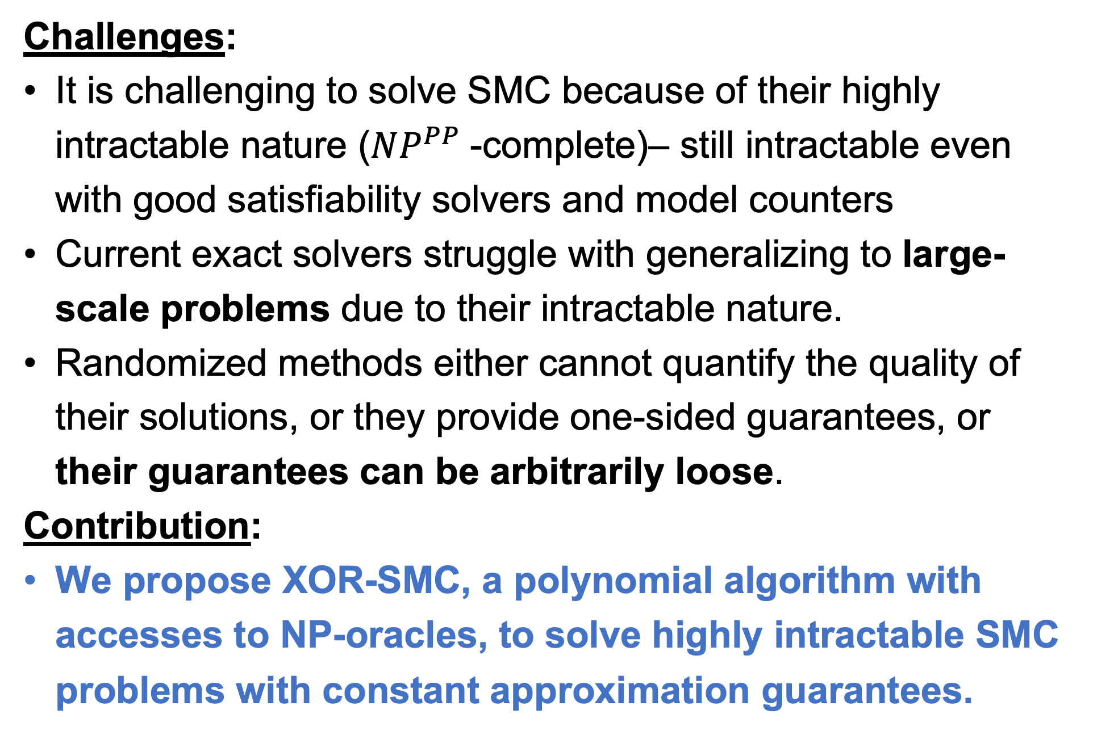
Solving Satisfiability Modulo Counting for Symbolic and Statistical AI Integration with Provable Guarantees
Jinzhao Li, Nan Jiang, Yexiang Xue*
{li4255, jiang631, yexiang}@purdue.edu
Department of Computer Science, Purdue University
Satisfiability Modulo Counting (SMC)
The XOR-SMC Algorithm
Constant Approximation Guarantee
The SMC problem is to determine if there exists $x=\left(x_{1},x_{2},…,x_{n}\right)∈𝒳={\left\{0,1\right\}}^{n}$ and $b=\left(b_{1},b_{2},…,b_{k}\right)∈{\left\{0,1\right\}}^{k}$ that satisfies the formula:
$$φ\left(x,b\right)∧\left[b_{i}⇒\left(\sum_{y_{i}∈𝒴_{i}}{f_{i}\left(x,y_{i}\right)}≥2^{q_{i}}\right)\right], ∀i∈\left\{1,…,k\right\},$$
where each $b_{i}$ is a Boolean predicate that is true if and only if the corresponding model count exceeds a threshold. Bold symbols (i.e., $x,y_{i}$ and $b$) are vectors of Boolean variables. $φ$, $f_{1}$, . . . , $f_{k}$ are Boolean functions. $∑f_{i}$ computes the number of satisfying assignments (model counts) of $f_{i}$.
Main Theorem (see details in the paper):
Let $0<η<1$ and $c≥\log\left(k+1\right)+1$. Select $T=\left\lceil \left(\left(n+k\right)ln2{−}\ln{η}\right)/α\left(c,k\right)\right\rceil$, we have
Suppose there exists $x_{0}∈{\left\{0,1\right\}}^{n}$ and $b_{0}∈{\left\{0,1\right\}}^{k}$, such that $SMC(φ,f_{1},…,f_{k},q_{1}+c, …,q_{k}+c)$ is true,
$$φ\left(x_{0},b_{0}\right)∧\left(\bigwedge{\left(b_{i}⇒\sum_{y_{i}∈𝒴_{i}}{f_{i}\left(x_{0},y_{i}\right)}≥2^{q_{i}+c}\right)}\right),$$
Then algorithm XOR-SMC$(φ,{\left\{f_{i}\right\}}_{i=1}^{k},{\left\{q_{i}\right\}}_{i=1}^{k},η,c)$ returns true with probability greater than $1 − η$.
Contrarily, suppose $SMC(φ,f_{1},…,f_{k},q_{1}+c, …,q_{k}+c)$ is not satisfiable, i.e., $∀x,b$,
$$¬\left(φ\left(x,b\right)∧\left(\bigwedge{\left(b_{i}⇒\sum_{y_{i}∈𝒴_{i}}{f_{i}\left(x,y_{i}\right)}≥2^{q_{i}−c}\right)}\right)\right),$$
Then algorithm XOR-SMC$(φ,{\left\{f_{i}\right\}}_{i=1}^{k},{\left\{q_{i}\right\}}_{i=1}^{k},η,c)$ returns false with probability greater than $1 − η$.
- As illustrated by Figure, the key motivation behind our proposed XOR-SMC algorithm is to notice that XOR-Counting described in preliminaries section can be written as a Boolean formula.
- When we embed this Boolean formula into a SMC problem, the problem translates into a Satisfiability-Modulo-SAT problem, or equivalently, an SAT problem.
- Examining the satisfiability status of the majority of the embeddings reduces error rates and gets a constant approximation guarantee.
Challenges:
It is challenging to solve SMC because of their highly intractable nature ($NP^{PP}$-complete)– still intractable even with good satisfiability solvers and model counters
Current exact solvers struggle with generalizing to large-scale problems due to their intractable nature.
Randomized methods either cannot quantify the quality of their solutions, or they provide one-sided guarantees, or their guarantees can be arbitrarily loose.
Contribution:
We propose XOR-SMC, a polynomial algorithm with accesses to NP-oracles, to solve highly intractable SMC problems with constant approximation guarantees.
Experiments: Shelter Allocation
We evaluate XOR-SMC on emergency shelter allocation problems, which aim to optimize accessibility (measured by the number of paths) from residential areas to shelters.
Preliminaries: XOR Counting
For a single predicate in the SMC problem: $\sum_{y∈𝒴}{f(x,y)}$, suppose we would like to know if it exceeds $2^{q}$. Consider the satisfiability (SAT) formula:
$$f\left(x,y\right)∧XOR_{1}\left(y\right)∧…∧XOR_{q}(y)$$
Here, $XOR_{1}, …, XOR_{q}$ are randomly sampled XOR constraints. The SAT formula above is likely to be satisfiable if more than $2^{q}$ different $y$ vectors render $f(x, y)$ true. Conversely, it is likely to be unsatisfiable if $f(x, y)$ has less than $2^{q}$ satisfying assignments.
Convert model counting to SAT formula
Our XOR-SMC finds the best shelter allocation plan in different sized maps in the shortest time.
SMC translates to SAT
Acknowledgement
This research was supported by NSF grants CCF-1918327.

